Slide 1
CS101 Algorithms and Data Structures
Stack
Textbook Ch 10.1
Notes:
Adapted from the slides by Douglas Wilhelm Harder of U Waterloo (https://ece.uwaterloo.ca/~dwharder/aads/Lecture_materials/)
May also contain material from the slides at https://courses.cs.washington.edu/courses/cse326/03wi/326lecturesb.shtml (by Dan Suciu of U Washington)

Slide 2
Outline
Stack ADT
Implementation
Example applications

Slide 3
Reverse-Polish Notation
Normally, mathematics is written using what we call in-fix notation:
(3 + 4) × 5 – 6
The operator is placed between two operands
One weakness: parentheses are required
(3 + 4) × 5 – 6 = 29
3 + 4 × 5 – 6 = 17
3 + 4 × (5 – 6) = –1
(3 + 4) × (5 – 6) = –7
Notes:
中缀表达式vs后缀表达式
中缀表达式：1. 遇到加减运算符需要等下一个运算符来判断运算优先级
2. 遇到左括号放入内存，优先级比运算符低（未入内存之前优先级比运算符高）
3. 遇到右括号后，将内存中的运算符和运算数一一输出直到左括号。。。

Slide 4
Reverse-Polish Notation
Alternatively, we can place the operands first, followed by the operator:
(3 + 4) × 5 – 6
3 4 + 5 × 6 –
Parsing reads left-to-right and performs any operation on the last two operands:
3 4 + 5 × 6 –
7 5 × 6 –
35 6 –
29
Notes:
后缀表达式：遇到运算数，则保存，遇到运算符，则取出运算符之前的两个运算数，运算后将结果存入内存，等待下一个运算符

Slide 5
Reverse-Polish Notation
Other examples:
3 4 5 × + 6 –
3 20 + 6 –
23 6 –
17
3 4 5 6 – × +
3 4 –1 × +
3 –4 +
–1
3 + 4 × 5 – 6= 17
3 + 4 × (5 – 6)= –1

Slide 6
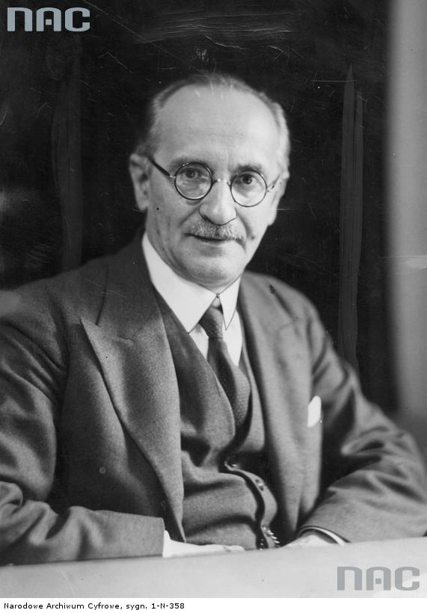
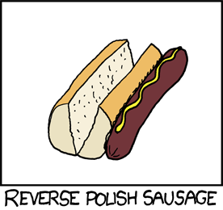
Reverse-Polish Notation
This is called reverse-Polish notation after the mathematician Jan Łukasiewicz
http://xkcd.com/645/
http://www.audiovis.nac.gov.pl/

Slide 7
Reverse-Polish Notation
Benefits:
No ambiguity and no brackets are required
It is the same process used by a computer to perform computations:
operands must be loaded into registers before operations can be performed on them
Notes:
Reverse-Polish can be processed using stacks
后缀表达式的优越：不用等待运算符，不需要定义priority，没有任何歧义。

Slide 8
Reverse-Polish Notation
The easiest way to parse reverse-Polish notation is to use an operand stack:
operands are processed by pushing them onto the stack
when processing an operator:
pop the last two items off the operand stack,
perform the operation, and
push the result back onto the stack
Notes:
后缀表达式具体最简单地实现方式，就是用堆栈

Slide 9
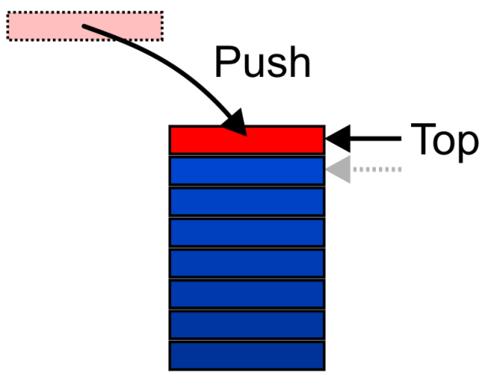
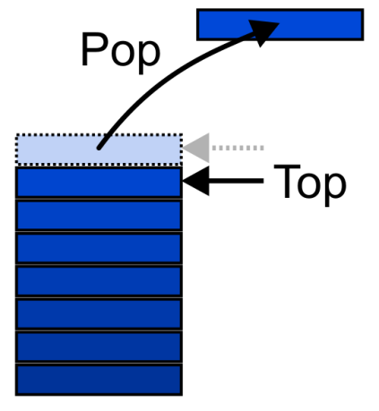
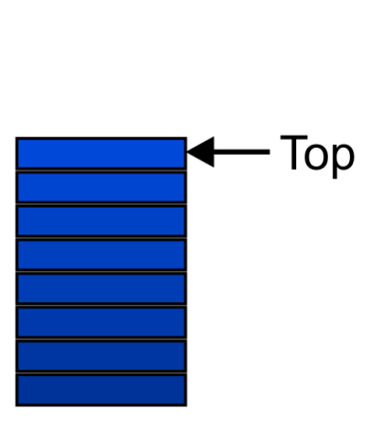
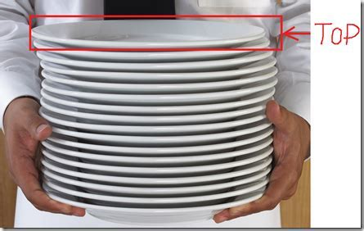
Stack ADT
Also called a last-in–first-out (LIFO) behaviour
Graphically, we may view these operations as follows:
Notes:
There are two exceptions associated with abstract stacks:
It is an undefined operation to call either pop or top on an empty stack
堆栈：具有一定操作约束的线性表
只在一端（栈顶，Top）做插入、删除
插入一个数据，叫做入栈 Push
删除/读取一个数据，叫做出栈 Pop
后入先出：Last-In-First-Out
盘子

Slide 10
Applications
Numerous applications:
Parsing code:
Matching parenthesis
XML (e.g., XHTML)
Tracking function calls
Dealing with undo/redo operations
Reverse-Polish calculators
Assembly language
Notes:
中缀表达式变换为后缀表达式：
基本策略：
运算数相对顺序不变
运算符号顺序发生改变
需要存储“等待中”的运算；要讲当前符号与“等待中”的最后一个运算符号比较
如果有括号，入栈前高于操作符，入栈后低于操作符

Slide 11
Reverse-Polish Notation
Evaluate the following reverse-Polish expression using a stack:
1 2 3 + 4 5 6 × – 7 × + – 8 9 × +

Slide 12
Reverse-Polish Notation
Push 1 onto the stack
1 2 3 + 4 5 6 × – 7 × + – 8 9 × +
1
Notes:
做法：遇到运算符之前运算数逐个入栈，遇到运算符，最后入站的两个数出栈，运算结果入栈。。。

Slide 13
Reverse-Polish Notation
Push 1 onto the stack
1 2 3 + 4 5 6 × – 7 × + – 8 9 × +
2
1

Slide 14
Reverse-Polish Notation
Push 3 onto the stack
1 2 3 + 4 5 6 × – 7 × + – 8 9 × +
3
2
1

Slide 15
Reverse-Polish Notation
Pop 3 and 2 and push 2 + 3 = 5
1 2 3 + 4 5 6 × – 7 × + – 8 9 × +
5
1

Slide 16
Reverse-Polish Notation
Push 4 onto the stack
1 2 3 + 4 5 6 × – 7 × + – 8 9 × +
4
5
1

Slide 17
Reverse-Polish Notation
Push 5 onto the stack
1 2 3 + 4 5 6 × – 7 × + – 8 9 × +
5
4
5
1

Slide 18
Reverse-Polish Notation
Push 6 onto the stack
1 2 3 + 4 5 6 × – 7 × + – 8 9 × +
6
5
4
5
1

Slide 19
Reverse-Polish Notation
Pop 6 and 5 and push 5 × 6 = 30
1 2 3 + 4 5 6 × – 7 × + – 8 9 × +
30
4
5
1

Slide 20
Reverse-Polish Notation
Pop 30 and 4 and push 4 – 30 = –26
1 2 3 + 4 5 6 × – 7 × + – 8 9 × +
–26
5
1

Slide 21
Reverse-Polish Notation
Push 7 onto the stack
1 2 3 + 4 5 6 × – 7 × + – 8 9 × +
7
–26
5
1

Slide 22
Reverse-Polish Notation
Pop 7 and –26 and push –26 × 7 = –182
1 2 3 + 4 5 6 × – 7 × + – 8 9 × +
–182
5
1

Slide 23
Reverse-Polish Notation
Pop –182 and 5 and push –182 + 5 = –177
1 2 3 + 4 5 6 × – 7 × + – 8 9 × +
–177
1

Slide 24
Reverse-Polish Notation
Pop –177 and 1 and push 1 – (–177) = 178
1 2 3 + 4 5 6 × – 7 × + – 8 9 × +
178

Slide 25
Reverse-Polish Notation
Push 8 onto the stack
1 2 3 + 4 5 6 × – 7 × + – 8 9 × +
8
178

Slide 26
Reverse-Polish Notation
Push 1 onto the stack
1 2 3 + 4 5 6 × – 7 × + – 8 9 × +
9
8
178

Slide 27
Reverse-Polish Notation
Pop 9 and 8 and push 8 × 9 = 72
1 2 3 + 4 5 6 × – 7 × + – 8 9 × +
72
178

Slide 28
Reverse-Polish Notation
Pop 72 and 178 and push 178 + 72 = 250
1 2 3 + 4 5 6 × – 7 × + – 8 9 × +
250

Slide 29
Reverse-Polish Notation
Thus
1 2 3 + 4 5 6 × – 7 × + – 8 9 × +
evaluates to the value on the top: 250
The equivalent in-fix notation is
((1 – ((2 + 3) + ((4 – (5 × 6)) × 7))) + (8 × 9))
We reduce the parentheses using order-of-operations:
1 – (2 + 3 + (4 – 5 × 6) × 7) + 8 × 9

Slide 30
Stack ADT
Uses an explicit linear ordering
Two principal operations
Push: insert an object onto the top of the stack
Pop: erase the object on the top of the stack
CreateStack: generate an empty stack
IsEmpty: determine if stack is empty
IsFull: determine if stack is full
Notes:
类型名称：堆栈
数据对象集：一个有0个或者多个元素的有穷线性表
操作集：
入栈 出栈 建立空的新栈 判断空栈或者栈满
Push and Pop可以交替进行。问：如果ABC三个元素，可不可能产生CAB这个顺序

Slide 31
Outline
Stack ADT
Implementation
Example applications

Slide 32
Implementations
We will look at two implementations of stacks:
Singly linked lists
One-ended arrays
The optimal asymptotic run time of any algorithm is Θ(1)
The run time of the algorithm is independent of the number of objects being stored in the container
Notes:
两种存储结构：单向链表 和 单向数组
顺路复习上节课不能细讲的一些细节

Slide 33
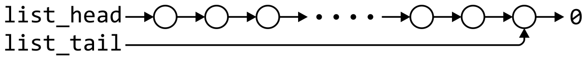
Linked-List Implementation
Operations at the front of a singly linked list are all Θ(1)
The desired behavior of an Abstract Stack may be reproduced by performing all operations at the front
 | Front/1st | Back/n^{th}
Find | Θ(1) | Θ(1)
Insert | Θ(1) | Θ(1)
Erase | Θ(1) | Θ(n)

Slide 34
Single_list Definition
The definition of single list class:
template <typename Type>
class Single_list {
public:
Single_list();
~Single_list();
int size() const; /* return the length of the List */
bool empty() const; /* return true when List is empty */
Type front() const; /* return the data in the first node */
Type back() const; /* return the data in the last node */
Single_node<Type> *head() const; /* return the first node */
Single_node<Type> *tail() const; /* return the last node */
int count( Type const & ) const; /* counts the number of instances of data*/
void push_front( Type const & ); /* insert a node as the first node*/
void push_back( Type const & ); /* insert a node as the last node*/
Type pop_front(); /* return the data in the first node and delete the first node*/
int erase( Type const & ); /* removes the nodes containing that integer*/
};

Slide 35
Stack-as-List Class
The stack class using a singly linked list has a single private member variable:
template <typename Type>
class Stack {
private:
Single_list<Type> list;
public:
bool empty() const;
Type top() const;
void push( Type const & );
Type pop();
};
Notes:
需要定义已经满了吗？如果决定要用链表表示堆栈，应该吧Top放在表尾还是表头？

Slide 36
Stack-as-List Class
The empty and push functions just call the appropriate functions of the Single_list class
template <typename Type>
bool Stack<Type>::empty() const {
return list.empty();
}
template <typename Type>
void Stack<Type>::push( Type const &obj ) {
list.push_front( obj );
}
Notes:
1。 判断是否空栈，直接继承单向链表是否是空表
2. 出栈操作，用的是 push_front (复习push_front) PPT1 Page 53-59
36

Slide 37


void push_front( int )
We could, however, note that when the list is empty, list_head == 0, thus we could shorten this to:
void List::push_front( int n ) {
list_head = new Node( n, list_head );
}
If it is empty, we start with:
and, if we try to add 81, we should end up with:
Notes:
新节点指向插入前list_head指向的节点（如果是空表，指向表尾）
新的list_head指向新的节点

Slide 38
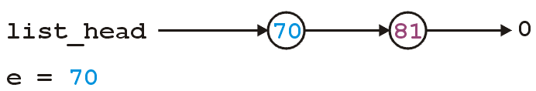
void push_front( int )
We could, however, note that when the list is empty, list_head == 0, thus we could shorten this to:
void List::push_front( int n ) {
list_head = new Node( n, list_head );
}
If it is not empty, we start with:
and, if we try to add 70, we should end up with:
Notes:
新节点指向插入前list_head指向的节点（这里假设是81，而不是表尾）
新的list_head指向新的节点

Slide 39
Stack-as-List Class
The top and pop functions, however, must check the boundary case:
template <typename Type>
Type Stack<Type>::top() const {
if ( empty() ) {
throw underflow();
}
return list.front();
}
template <typename Type>
Type Stack<Type>::pop() {
if ( empty() ) {
throw underflow();
}
return list.pop_front();
}
Notes:
读取栈顶数据：判断不是空表，list.front();
出栈：删除表头节点

Slide 40
int pop_front()
The correct implementation assigns a temporary pointer to point to the node being deleted:
int List::pop_front() {
if ( empty() ) {
throw underflow();
}
int e = front();
Node *ptr = list_head;
list_head = list_head->next();
delete ptr;
return e;
}
int front() const
int List::front() const {
if ( empty() ) {
throw underflow(); }
return head()->retrieve();
}
Notes:
所以一定需要一个临时节点，把目前head（）取出，把list_head指向下一个节点，然后删除临时节点，并返回70

Slide 41
int pop_front()
The correct implementation assigns a temporary pointer to point to the node being deleted:
int List::pop_front() {
if ( empty() ) {
throw underflow();
}
int e = front();
Node *ptr = list_head;
list_head = list_head->next();
delete ptr;
return e;
}
int front() const
int List::front() const {
if ( empty() ) {
throw underflow(); }
return head()->retrieve();
}
Notes:
所以一定需要一个临时节点，把目前head（）取出，把list_head指向下一个节点，然后删除临时节点，并返回70

Slide 42
int pop_front()
The correct implementation assigns a temporary pointer to point to the node being deleted:
int List::pop_front() {
if ( empty() ) {
throw underflow();
}
int e = front();
Node *ptr = list_head;
list_head = list_head->next();
delete ptr;
return e;
}
Notes:
所以一定需要一个临时节点，把目前head（）取出，把list_head指向下一个节点，然后删除临时节点，并返回70

Slide 43
int pop_front()
The correct implementation assigns a temporary pointer to point to the node being deleted:
int List::pop_front() {
if ( empty() ) {
throw underflow();
}
int e = front();
Node *ptr = list_head;
list_head = list_head->next();
delete ptr;
return e;
}
*ptr
Notes:
所以一定需要一个临时节点，把目前head（）取出，把list_head指向下一个节点，然后删除临时节点，并返回70

Slide 44
int pop_front()
The correct implementation assigns a temporary pointer to point to the node being deleted:
int List::pop_front() {
if ( empty() ) {
throw underflow();
}
int e = front();
Node *ptr = list_head;
list_head = list_head->next();
delete ptr;
return e;
}
*ptr
Notes:
所以一定需要一个临时节点，把目前head（）取出，把list_head指向下一个节点，然后删除临时节点，并返回70

Slide 45
int pop_front()
The correct implementation assigns a temporary pointer to point to the node being deleted:
int List::pop_front() {
if ( empty() ) {
throw underflow();
}
int e = front();
Node *ptr = list_head;
list_head = list_head->next();
delete ptr;
return e;
}
*ptr
Notes:
所以一定需要一个临时节点，把目前head（）取出，把list_head指向下一个节点，然后删除临时节点，并返回70

Slide 46
int pop_front()
The correct implementation assigns a temporary pointer to point to the node being deleted:
int List::pop_front() {
if ( empty() ) {
throw underflow();
}
int e = front();
Node *ptr = list_head;
list_head = list_head->next();
delete ptr;
return e;
}
*ptr
Notes:
所以一定需要一个临时节点，把目前head（）取出，把list_head指向下一个节点，然后删除临时节点，并返回70

Slide 47
int pop_front()
The correct implementation assigns a temporary pointer to point to the node being deleted:
int List::pop_front() {
if ( empty() ) {
throw underflow();
}
int e = front();
Node *ptr = list_head;
list_head = list_head->next();
delete ptr;
return e;
}
Notes:
所以一定需要一个临时节点，把目前head（）取出，把list_head指向下一个节点，然后删除临时节点，并返回70

Slide 48
int pop_front()
The correct implementation assigns a temporary pointer to point to the node being deleted:
int List::pop_front() {
if ( empty() ) {
throw underflow();
}
int e = front();
Node *ptr = list_head;
list_head = list_head->next();
delete ptr;
return e;
}
Notes:
所以一定需要一个临时节点，把目前head（）取出，把list_head指向下一个节点，然后删除临时节点，并返回70

Slide 49
Stack-as-List Class
A constructor and destructor is not needed
Because list is declared, the compiler will call the constructor of the Single_list class when the Stack is constructed
Notes:
49

Slide 50

Array Implementation
For one-ended arrays, all operations at the back are Θ(1)
 | Front/1st | Back/n^{th}
Find | Θ(1) | Θ(1)
Insert | Θ(n) | Θ(1)
Erase | Θ(n) | Θ(1)
Notes:
堆栈栈顶在array的尾部

Slide 51
Stack-as-Array Class
template <typename Type>
class Stack {
private:
int stack_size; //number of objects in the stack
int array_capacity; //capacity of the array
Type *array;
public:
Stack( int = 10 );
~Stack();
bool empty() const;
Type top() const;
void push( Type const & );
Type pop();
};
Notes:
栈的顺序存储通常由一个一维数组和一个记录栈顶元素位置的变量组成（表示栈顶的下标）
堆栈数据数量，堆栈最大容量 不需要指针

Slide 52
Constructor
The class is only storing the address of the array
We must allocate memory for the array and initialize the member variables
#include <algorithm>
// ...
template <typename Type>
Stack<Type>::Stack( int n ):
stack_size( 0 ),
array_capacity( std::max( 1, n ) ),
array( new Type[array_capacity] ) {
// Empty constructor
}
Notes:
初始stack_size=0;
容量是N

Slide 53
Constructor
template <typename Type>
class Stack {
private:
int stack_size;
int array_capacity;
Type *array;
public:
Stack( int = 10 );
~Stack();
bool empty() const;
Type top() const;
void push( Type const & );
Type pop();
};
template <typename Type>
Stack<Type>::Stack( int n ):
stack_size( 0 ),
array_capacity( std::max( 1, n ) ),
array( new Type[array_capacity] ) {
// Empty constructor
}
Warning: in C++, the variables are initialized in the order in which they are defined:
Notes:
53

Slide 54
Destructor
The destructor must release the memory for the array
template <typename Type>
Stack<Type>::~Stack() {
delete [] array;
}
Notes:
顺便提一下lincked_list怎么删除

Slide 55
Empty
The stack is empty if the stack size is zero:
template <typename Type>
bool Stack<Type>::empty() const {
return ( stack_size == 0 );
}
Notes:
判断是否空栈：只需要看stack_size是否为零

Slide 56
Top
If there are n objects in the stack, the last is located at index n – 1
template <typename Type>
Type Stack<Type>::top() const {
if ( empty() ) {
throw underflow();
}
return array[stack_size - 1];
}
Notes:
Top（）：求栈顶元素的数值：如果栈中有N个元素，那么栈顶在stack_size-1的位置上
56

Slide 57
Pop
Removing an object simply involves reducing the size
By decreasing the size, the previous top of the stack is now at the location stack_size
template <typename Type>
Type Stack<Type>::pop() {
if ( empty() ) {
throw underflow();
}
--stack_size;
return array[stack_size];
}
Notes:
出栈先看是否为空栈；栈size减一；返回栈顶元素 （栈顶元素的位置一直是stack_size减一）
57

Slide 58
Push
Pushing an object onto the stack can only be performed if the array is not full
template <typename Type>
void Stack<Type>::push( Type const &obj ) {
if ( stack_size == array_capacity ) {
throw overflow();
}
array[stack_size] = obj;
++stack_size;
}
Notes:
看出来利用顺序存储不需要指针，直接计算位置

Slide 59
Exceptions
The case where the array is full is not an exception defined in the Abstract Stack
If the array is filled, we have five options:
Increase the size of the array
Throw an exception
Ignore the element being pushed
Replace the current top of the stack
Put the pushing process to “sleep” until something else removes the top of the stack
Include a member function bool full() const;
Notes:
如果堆栈已满，可以有很多处理办法：

Slide 60
Array Capacity
The best option is to increase the array capacity
If we increase the array capacity, the question is:
How much?
By a constant? array_capacity += c;
By a multiple? array_capacity *= c;

Slide 61
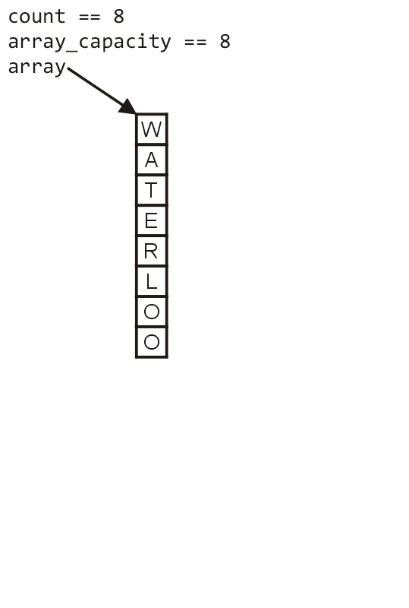
Array Capacity
First, let us visualize what must occur to allocate new memory

Slide 62
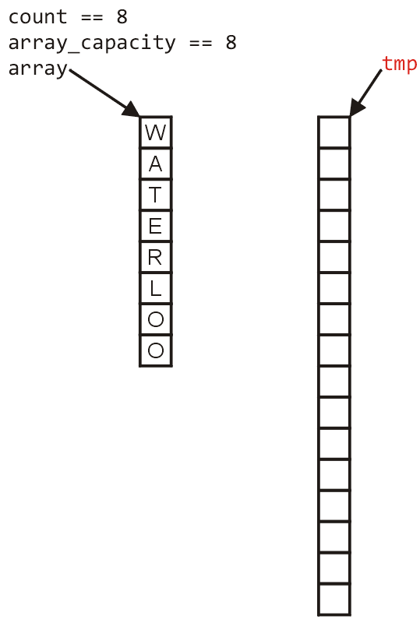
Array Capacity
First, this requires a call to new Type[N] where N is the new capacity
We must have access to this so we must store the address returned by new in a local variable, say tmp

Slide 63
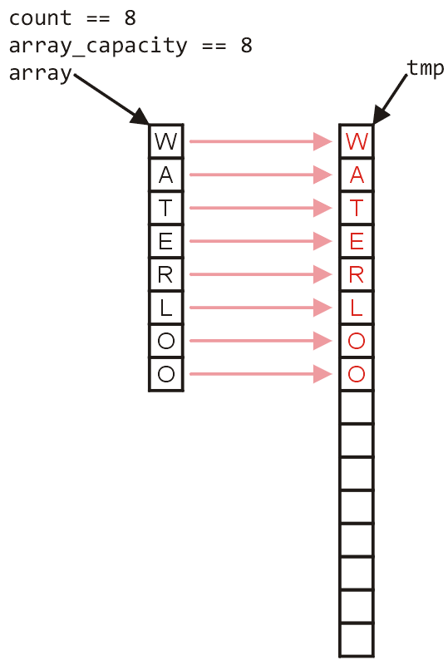
Array Capacity
Next, the values must be copied over

Slide 64
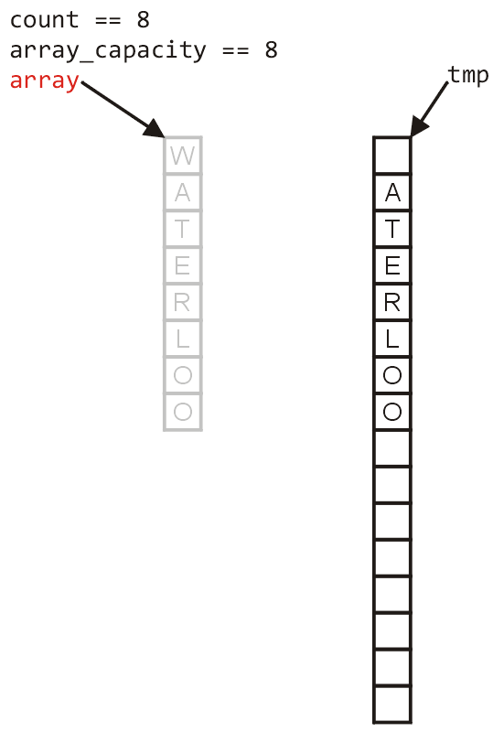
Array Capacity
W
The memory for the original array must be deallocated

Slide 65
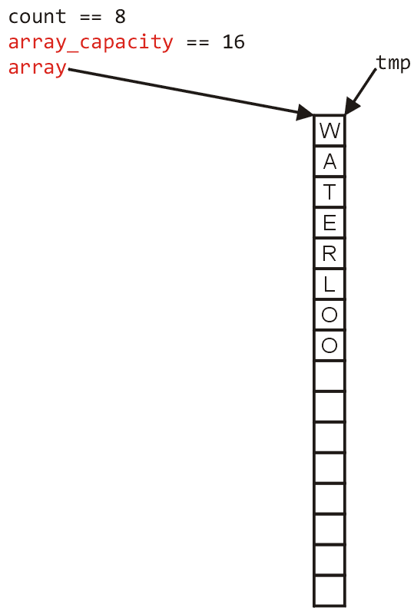
Array Capacity
Finally, the appropriate member variables must be reassigned

Slide 66
Array Capacity
The implementation:
void double_capacity() {
}

Slide 67
Array Capacity
tmp_array
The implementation:
void double_capacity() {
Type *tmp_array = new Type[2*array_capacity];
}

Slide 68
Array Capacity
tmp_array
The implementation:
void double_capacity() {
Type *tmp_array = new Type[2*array_capacity];
for ( int i = 0; i < array_capacity; ++i ) {
tmp_array[i] = array[i];
}
}

Slide 69
Array Capacity
tmp_array
W
The implementation:
void double_capacity() {
Type *tmp_array = new Type[2*array_capacity];
for ( int i = 0; i < array_capacity; ++i ) {
tmp_array[i] = array[i];
}
delete [] array;
}

Slide 70
Array Capacity
tmp_array
The implementation:
void double_capacity() {
Type *tmp_array = new Type[2*array_capacity];
for ( int i = 0; i < array_capacity; ++i ) {
tmp_array[i] = array[i];
}
delete [] array;
array = tmp_array;
}

Slide 71
Array Capacity
tmp_array
The implementation:
void double_capacity() {
Type *tmp_array = new Type[2*array_capacity];
for ( int i = 0; i < array_capacity; ++i ) {
tmp_array[i] = array[i];
}
delete [] array;
array = tmp_array;
array_capacity *= 2;
}

Slide 72
Array Capacity
Back to the original question:
How much do we change the capacity?
Add a constant?
Multiply by a constant?
First, we recognize that any time that we push onto a full stack, this requires n copies and the run time is Θ(n)
Therefore, push is usually Θ(1) except when new memory is required

Slide 73
Array Capacity
To state the average run time, we will introduce the concept of amortized time:
If n operations requires Θ(f(n)), we will say that an individual operation has an amortized run time of Θ(f(n)/n)
Therefore, if inserting n objects requires:
Θ(n²) copies, the amortized time is Θ(n)
Θ(n) copies, the amortized time is Θ(1)

Slide 74
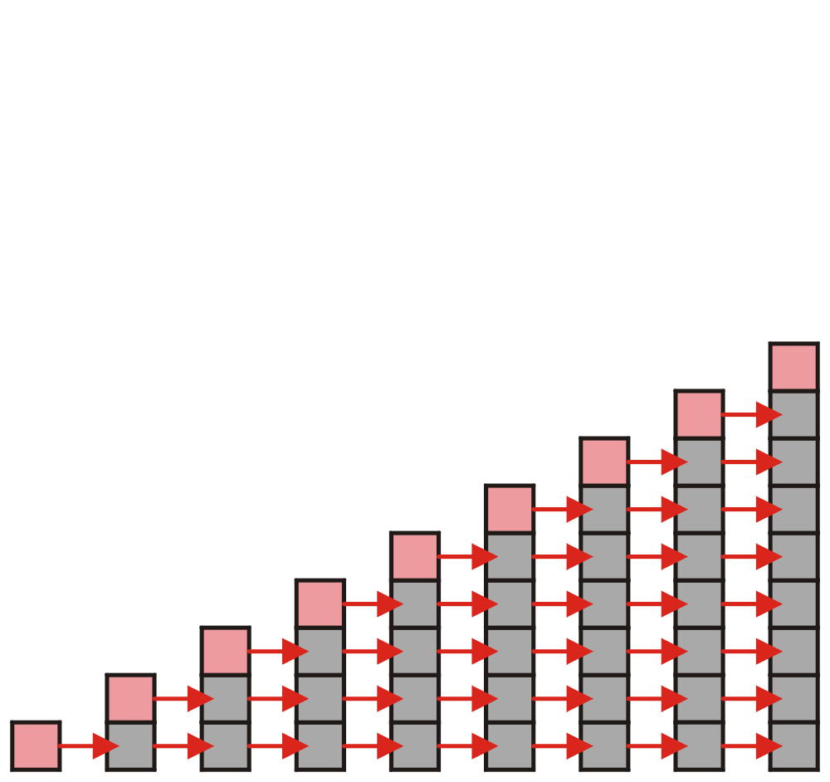
Array Capacity
Let us consider the case of increasing the capacity by 1 each time the array is full
With each insertion when the array is full, this requires all entries to be copied

Slide 75
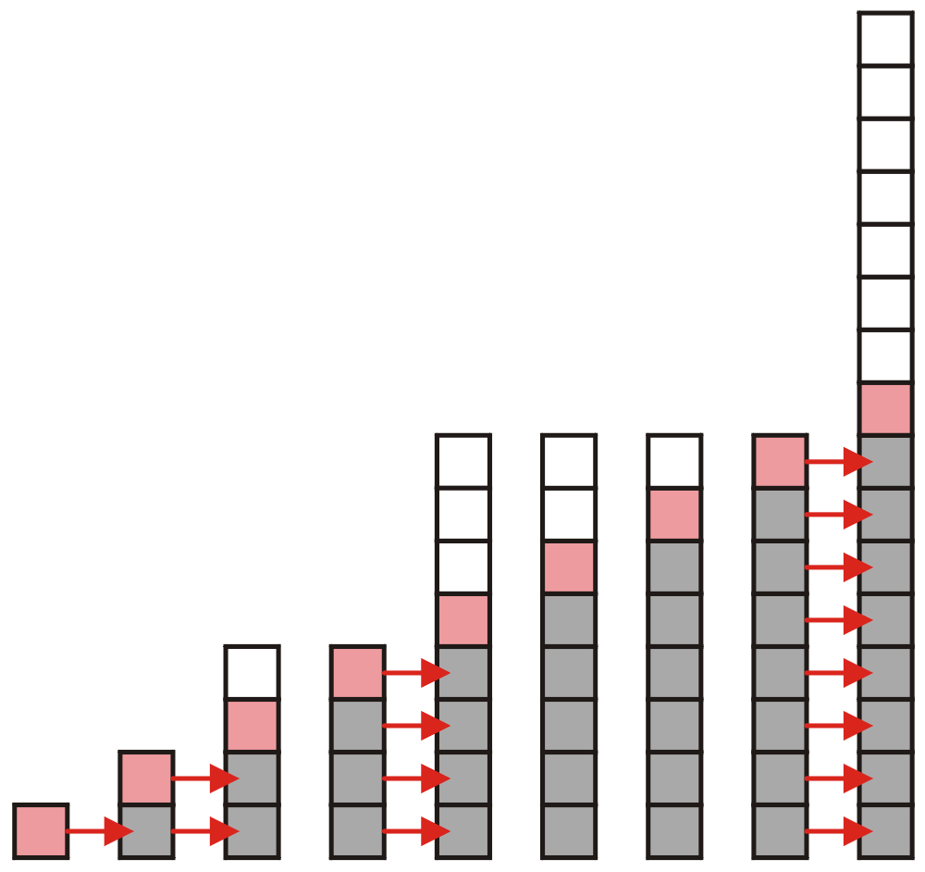
Array Capacity
Suppose we double the number of entries each time the array is full
Now the number of copies appears to be significantly fewer

Slide 76
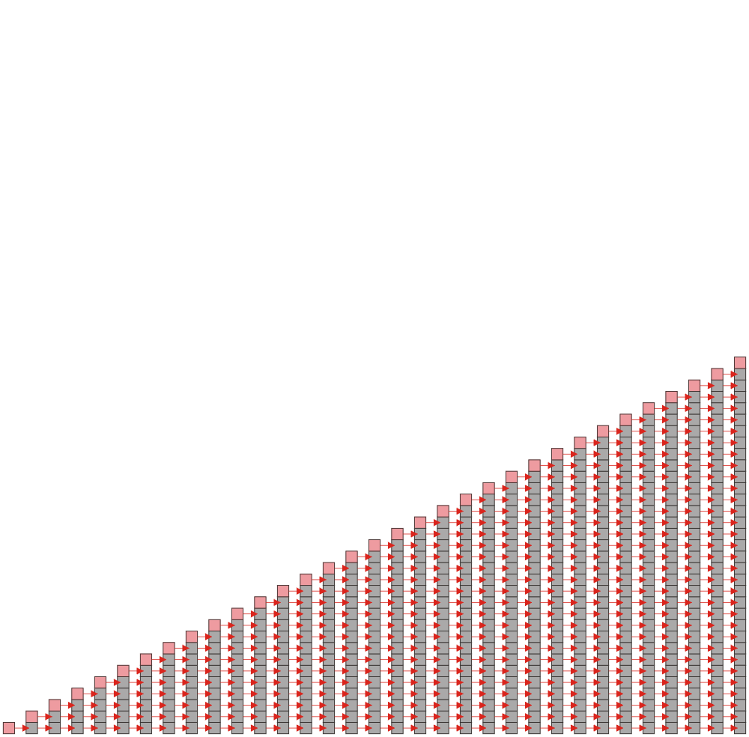
Array Capacity
Suppose we insert k objects
The pushing of the k^{th} object on the stack requires k-1 copies
The total number of copies is now given by:
Therefore, the amortized number of copies is given by
Therefore each push must run in Θ(n) time
The wasted space, however is Θ(1)

Slide 77
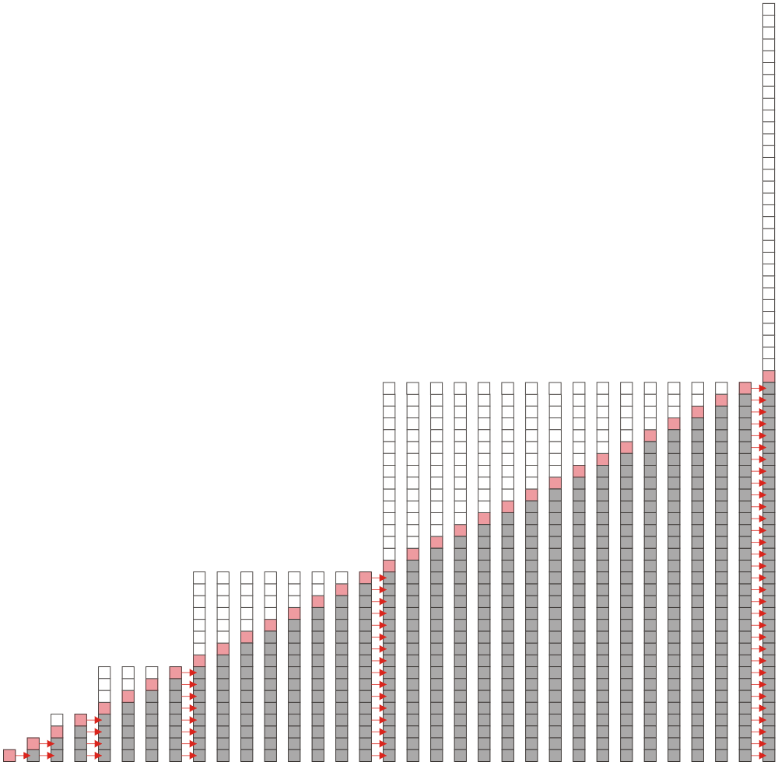
Array Capacity
Suppose we double the array size each time it is full:
Inserting n objects would require 1, 2, 4, 8, ..., all the way up to the largest 2^{k} < n or
Therefore the amortized number of copies per insertion is Θ(1)
The wasted space, however is O(n)
Notes:
第一次扩容在copy1个，2个，4个。。。
扩容这件事情发生了多少次呢？每次元素数目到达2的指数次幂，就需要扩容一次，那么总共发生了以二为底，lgn次
这里面这个符号代表了lgN能表达的最大的整数

Slide 78
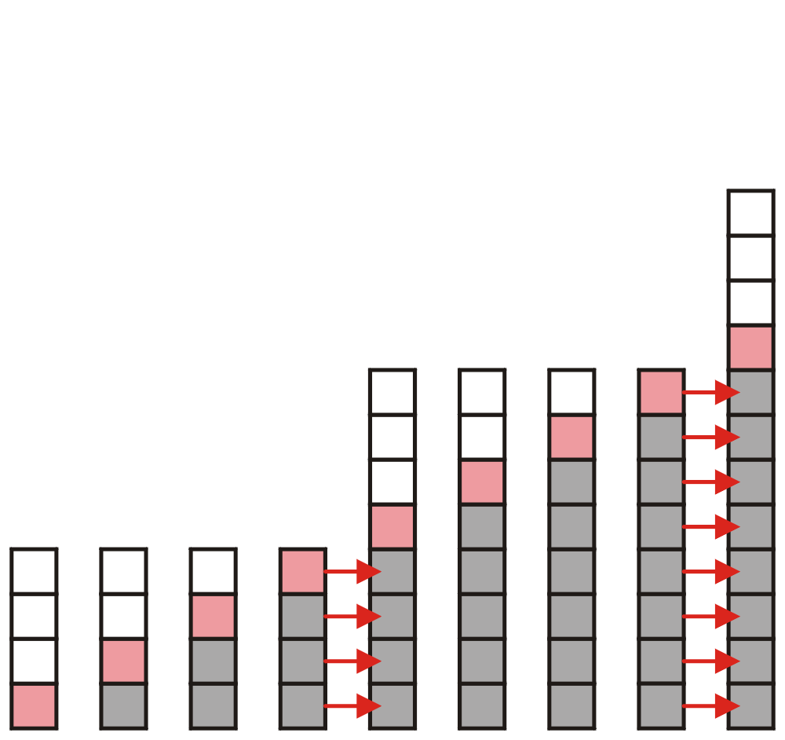
Array Capacity
What if we increase the array size by a larger constant?
For example, increase the array size by 4, 8, or 100?
Notes:
留作思考吧，我觉得时间不够

Slide 79
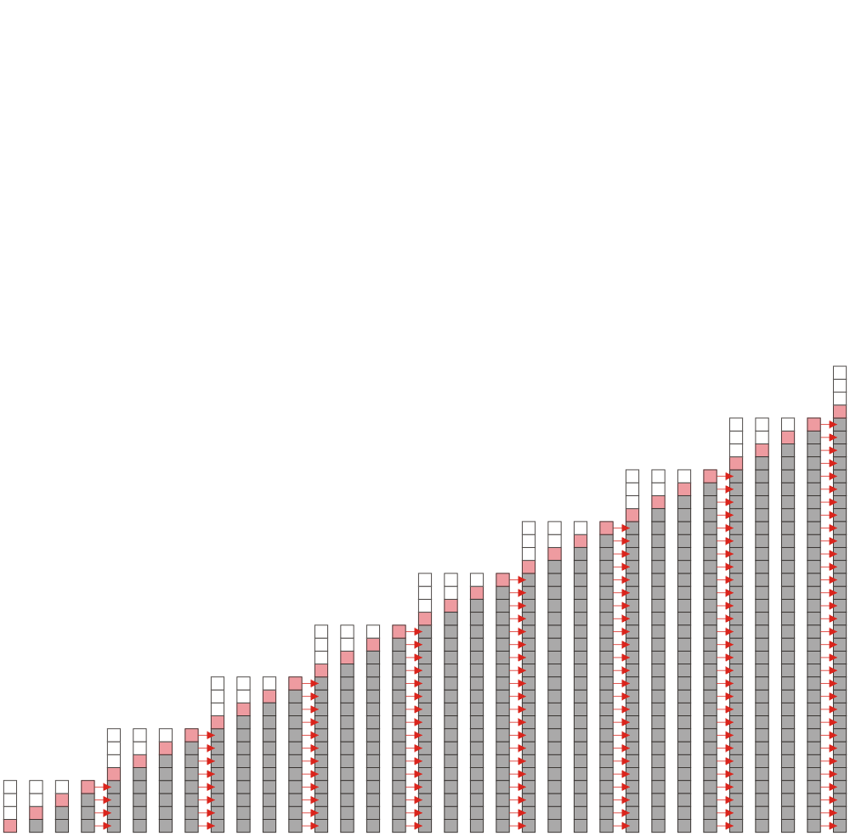
Array Capacity
Suppose we increase it by a constant value m
Therefore, the amortized run time per insertion is Θ(n)

Slide 80
Array Capacity
 | Copies per Insertion | Unused Memory
Increase by 1 | n – 1 | 0
Increase by m | n/m | m – 1
Increase by a factor of 2 | 1 | n
Increase by a factor of r > 1 | 1/(r – 1) | (r – 1)n
Note the difference in worst-case amortized scenarios:

Slide 81
Outline
Stack ADT
Implementation
Example applications

Slide 82
Application: Parsing
Most parsing uses stacks
Examples includes:
Matching tags in XHTML
In C++, matching
parentheses ( ... )
brackets, and [ ... ]
braces { ... }

Slide 83
Parsing XHTML
A markup language is a means of annotating a document to given context to the text
The annotations give information about the structure or presentation of the text
The best known example is HTML, or HyperText Markup Language
We will look at XHTML

Slide 84
Parsing XHTML
XHTML is made of nested
opening tags, e.g., <some_identifier>, and
matching closing tags, e.g., </some_identifier>
<html>
<head><title>Hello</title></head>
<body><p>This appears in the <i>browser</i>.</p></body>
</html>
Nesting indicates that any closing tag must match the most recent opening tag

Slide 85
Parsing XHTML
Strategy for parsing XHTML:
read though the XHTML linearly
place the opening tags in a stack
when a closing tag is encountered, check that it matches what is on top of the stack

Slide 86
Parsing XHTML
<html>
<head><title>Hello</title></head>
<body><p>This appears in the <i>browser</i>.</p></body>
</html>
<html>

Slide 87
Parsing XHTML
<html>
<head><title>Hello</title></head>
<body><p>This appears in the <i>browser</i>.</p></body>
</html>
<html> | <head>

Slide 88
Parsing XHTML
<html>
<head><title>Hello</title></head>
<body><p>This appears in the <i>browser</i>.</p></body>
</html>
<html> | <head> | <title>

Slide 89
Parsing XHTML
<html>
<head><title>Hello</title></head>
<body><p>This appears in the <i>browser</i>.</p></body>
</html>
<html> | <head> | <title>

Slide 90
Parsing XHTML
<html>
<head><title>Hello</title></head>
<body><p>This appears in the <i>browser</i>.</p></body>
</html>
<html> | <head>

Slide 91
Parsing XHTML
<html>
<head><title>Hello</title></head>
<body><p>This appears in the <i>browser</i>.</p></body>
</html>
<html> | <body>

Slide 92
Parsing XHTML
<html>
<head><title>Hello</title></head>
<body><p>This appears in the <i>browser</i>.</p></body>
</html>
<html> | <body> | <p>

Slide 93
Parsing XHTML
<html>
<head><title>Hello</title></head>
<body><p>This appears in the <i>browser</i>.</p></body>
</html>
<html> | <body> | <p> | <i>

Slide 94
Parsing XHTML
<html>
<head><title>Hello</title></head>
<body><p>This appears in the <i>browser</i>.</p></body>
</html>
<html> | <body> | <p> | <i>

Slide 95
Parsing XHTML
<html>
<head><title>Hello</title></head>
<body><p>This appears in the <i>browser</i>.</p></body>
</html>
<html> | <body> | <p>

Slide 96
Parsing XHTML
<html>
<head><title>Hello</title></head>
<body><p>This appears in the <i>browser</i>.</p></body>
</html>
<html> | <body>

Slide 97
Parsing XHTML
<html>
<head><title>Hello</title></head>
<body><p>This appears in the <i>browser</i>.</p></body>
</html>
<html>

Slide 98
Parsing XHTML
We are finished parsing, and the stack is empty
Possible errors:
a closing tag which does not match the opening tag on top of the stack
a closing tag when the stack is empty
the stack is not empty at the end of the document

Slide 99
Parsing C++
Like opening and closing tags, C++ parentheses, brackets, and braces must be similarly nested:
void initialize( int *array, int n ) {
for ( int i = 0; i < n; ++i ) {
array[i] = 0;
}
}

Slide 100
Function calls
int a(){
b();
c();
return 0;
}
int b(){ return 0; }
int c(){ return 0; }
int main(){
a();
return 0;
}

Slide 101
Function calls
main
main() calls a()
main | a
a() calls b()
main | a | b
b() returns
main | a
a() calls c()
main | a | c
c() returns
main | a
a() returns
main

Slide 102
Function calls
int a(){
return a();
}

Slide 103
Function calls
calls a()
a
a() calls a()
a | a
a() calls a()
a | a | a
a() calls a()
a | a | a | a
a | a | a | a
a() calls a()
?
Stack Overflow!

Slide 104

StackOverflow

Slide 105
Summary
Stack ADT
Push, pop, LIFO
Implementation
Linked list
Array
How to increase the array capacity
Applications
Parsing XHTML
Function calls
Reverse-Polish Notation

Slide 106

Standard Template Library
The Standard Template Library (STL) has a wrapper class stack with the following declaration:
template <typename T>
class stack {
public:
stack(); // not quite true...
bool empty() const;
int size() const;
const T & top() const;
void push( const T & );
void pop();
};

Slide 107
Standard Template Library
#include <iostream>
#include <stack>
using namespace std;
int main() {
stack<int> istack;
istack.push( 13 );
istack.push( 42 );
cout << "Top: " << istack.top() << endl;
istack.pop(); // no return value
cout << "Top: " << istack.top() << endl;
cout << "Size: " << istack.size() << endl;
return 0;
}

Slide 108
Standard Template Library
The reason that the stack class is termed a wrapper is because it uses a different container class to actually store the elements
The stack class simply presents the stack interface with appropriately named member functions:
push, pop , and top

